Slide 1
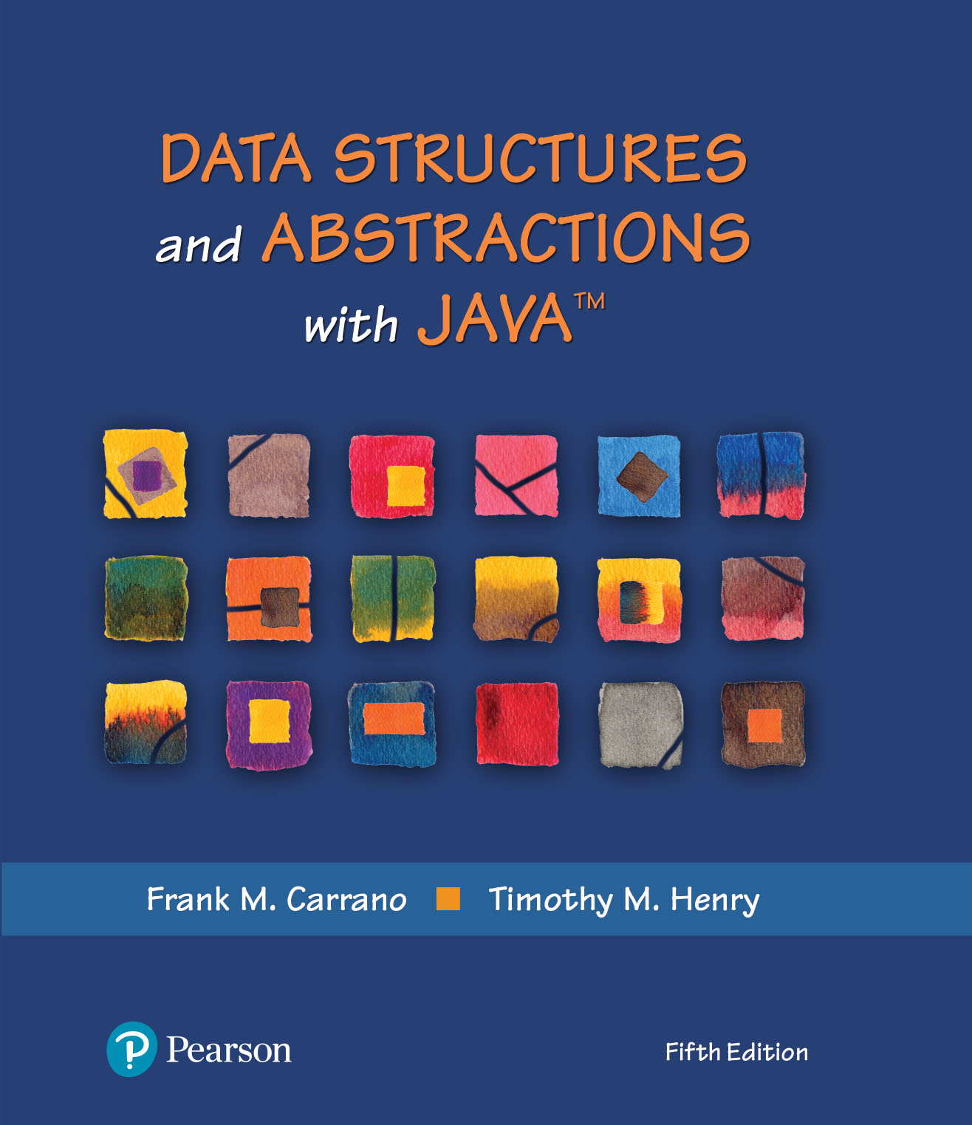
Data Structures and Abstractions with Java™
5th Edition
Module 18 - Sorting
Including:
Chapter 15 – Intro to Sorting
Chapter 16 – Faster Sorting

Slide 2
Overview
Sorting is the process of ordering a set of items
Like data structures, sorting algorithms are evaluated based on
Their speed
The amount of memory overhead they require
The programming effort required to implement them
Classic sorting algorithms include the Selection sort, Insertion sort, Shell sort
Additional sorts include the Merge sort, Quick sort, Radix sort and the Binary Tree Sort
We will look at a Merge sort in the next module.
Each of the above sorts has its merits
2
2

Slide 3
Ordering Items
Most common orderings are ascending and descending order
In the context of data structures
Nodes are sorted based on the contents of a field
To produce sorted output listings
To improve the speed of their data structure
E.g., Binary search tree and a sorted array fetch are O(log2n)
But sorting takes time, therefore we need
Fast algorithms O(log2n)
Good strategies
Store sorted (mostly fetch operations)
Sort before output (many inserts, deletes, and updates)
3

Slide 4
Sorting Algorithm Speed
All sorting algorithms repeatedly
Compare two items
Swap them if they are out of order
Therefore the speed of a sorting algorithm is dependent on the
Number of comparisons it makes
Number of data swaps it makes
When sorting nodes, shallow swaps save time
4

Slide 5
Sorting
We seek algorithms to arrange items, ai such that: entry 1 ≤ entry 2 ≤ . . . ≤ entry n
Sorting an array is usually easier than sorting a chain of linked nodes
Efficiency of a sorting algorithm is significant

Slide 6
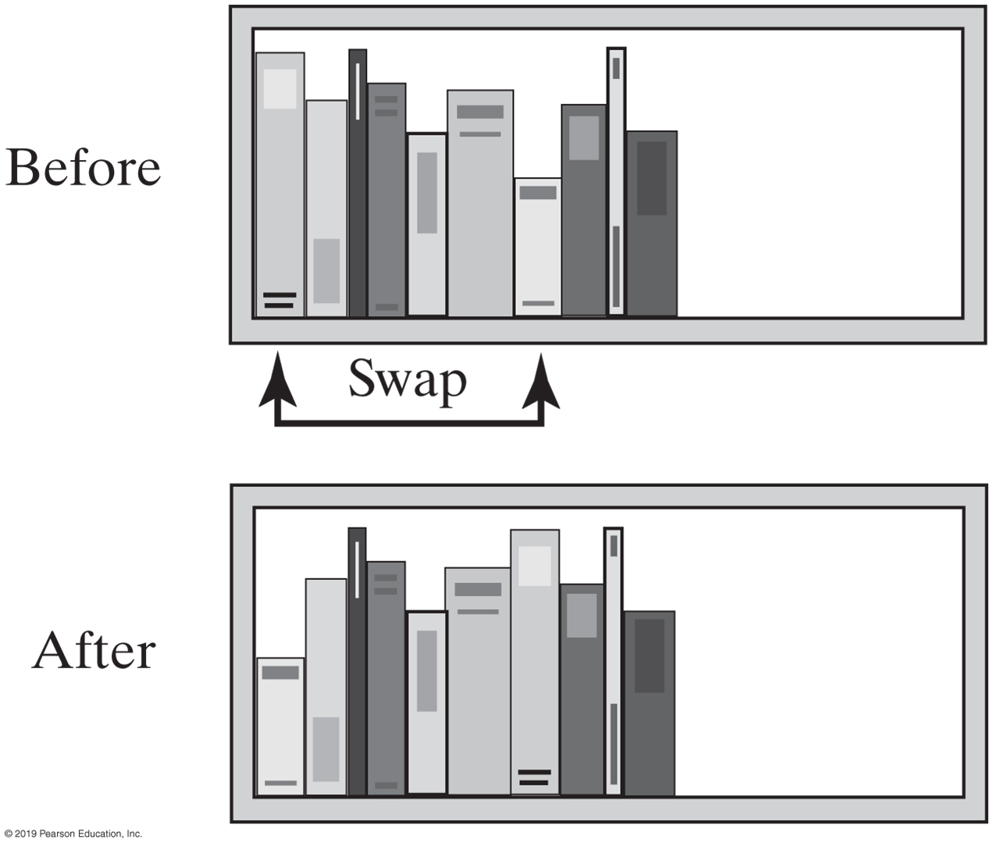
Selection Sort
FIGURE 15-1 Before and after exchanging the shortest book and the first book

Slide 7
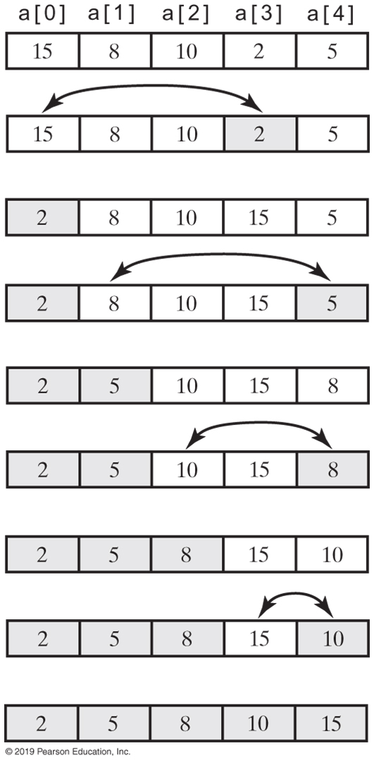
Selection Sort
FIGURE 15-2 A selection sort of an array of integers into ascending order

Slide 8
Iterative Selection Sort
Algorithm selectionSort(a, n)
// Sorts the first n entries of an array a.
for (index = 0; index < n − 1; index++)
{
indexOfNextSmallest = the index of the smallest value among
a[index], a[index + 1], . . . , a[n − 1]
Interchange the values of a[index] and a[indexOfNextSmallest]
// Assertion: a[0] ≤ a[1] ≤ . . . ≤ a[index], and these are the smallest
// of the original array entries. The remaining array entries begin at a[index + 1].
}
This pseudocode describes an iterative algorithm for the selection sort

Slide 9
Iterative Selection Sort (Part 1)
/** A class of static, iterative methods for sorting an array of
Comparable objects from smallest to largest. */
public class SortArray
{
/** Sorts the first n objects in an array into ascending order.
@param a An array of Comparable objects.
@param n An integer > 0. */
public static <T extends Comparable<? super T>>
void selectionSort(T[] a, int n)
{
for (int index = 0; index < n - 1; index++)
{
int indexOfNextSmallest = getIndexOfSmallest(a, index, n - 1);
swap(a, index, indexOfNextSmallest);
// Assertion: a[0] <= a[1] <= . . . <= a[index] <= all other a[i]
} // end for
} // end selectionSort
LISTING 15-1 A class for sorting an array using selection sort

Slide 10
Iterative Selection Sort (Part 2)
// Finds the index of the smallest value in a portion of an array a.
// Precondition: a.length > last >= first >= 0.
// Returns the index of the smallest value among
// a[first], a[first + 1], . . . , a[last].
private static <T extends Comparable<? super T>>
int getIndexOfSmallest(T[] a, int first, int last)
{
T min = a[first];
int indexOfMin = first;
for (int index = first + 1; index <= last; index++)
{
if (a[index].compareTo(min) < 0)
{
min = a[index];
indexOfMin = index;
} // end if
// Assertion: min is the smallest of a[first] through a[index].
} // end for
return indexOfMin;
} // end getIndexOfSmallest
LISTING 15-1 A class for sorting an array using selection sort

Slide 11
Iterative Selection Sort (Part 3)
// Swaps the array entries a[i] and a[j].
private static void swap(Object[] a, int i, int j)
{
Object temp = a[i];
a[i] = a[j];
a[j] = temp;
} // end swap
} // end SortArray
LISTING 15-1 A class for sorting an array using selection sort

Slide 12
Recursive Selection Sort
Algorithm selectionSort(a, first, last)
// Sorts the array entries a[first] through a[last] recursively.
if (first < last)
{
indexOfNextSmallest = the index of the smallest value among
a[first], a[first + 1], . . . , a[last]
Interchange the values of a[first] and a[indexOfNextSmallest]
// Assertion: a[0] ≤ a[1] ≤ . . . ≤ a[first] and these are the smallest
// of the original array entries. The remaining array entries begin at a[first + 1].
selectionSort(a, first + 1, last)
}
Recursive selection sort algorithm

Slide 13
Efficiency of Selection Sort
Selection sort is O(n²) regardless of the initial order of the entries.
Requires O(n²) comparisons
Does only O(n) swaps

Slide 14
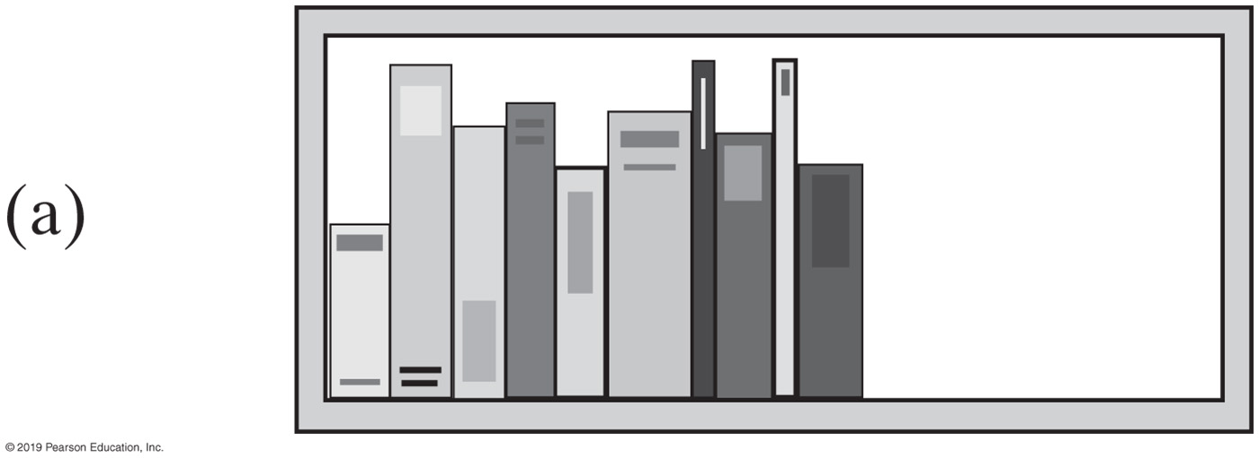
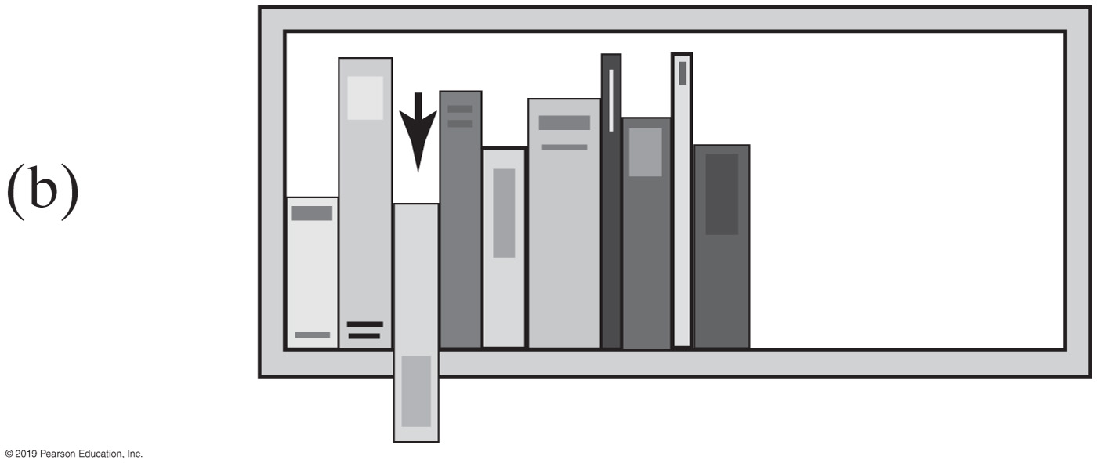
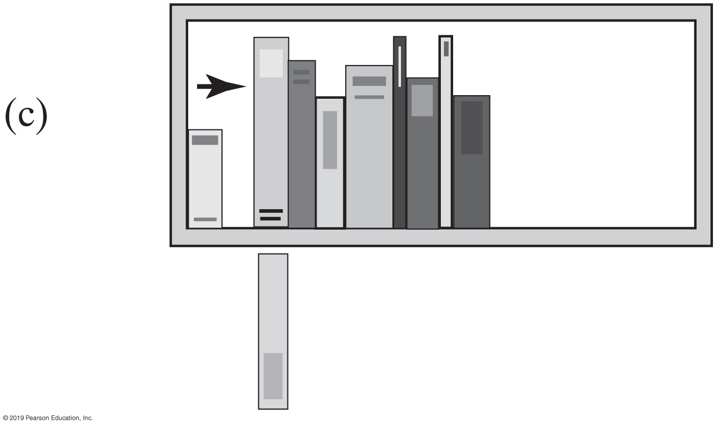
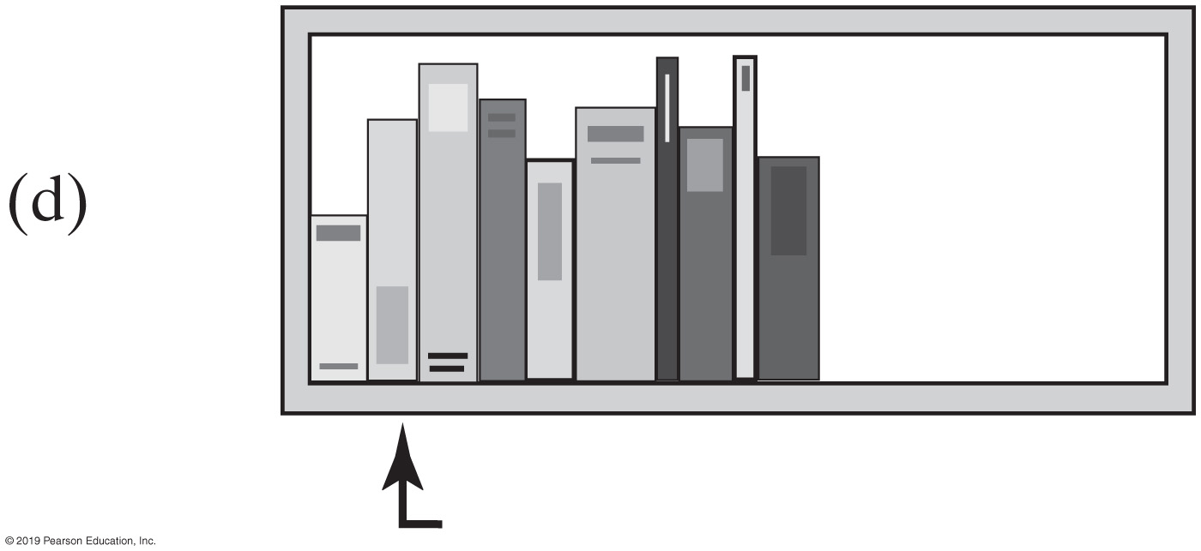
Insertion Sort
FIGURE 15-3 The placement of the third book during an insertion sort

Slide 15
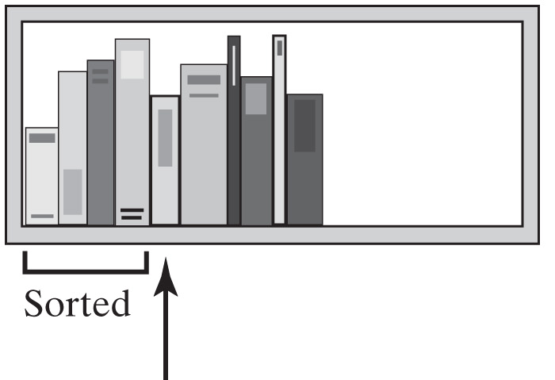
Insertion Sort
Remove the next unsorted book.
Slide the sorted books to the right one by one until you find the right spot for the removed book.
Insert the book into its new position
FIGURE 15-4 An insertion sort of books

Slide 16
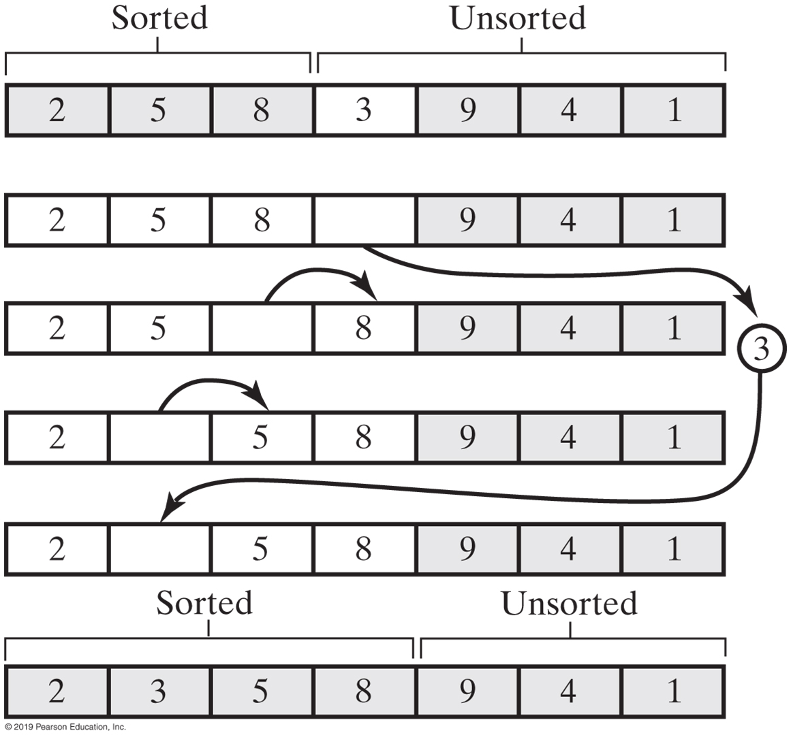
Insertion Sort
FIGURE 15-5 Inserting the next unsorted entry into its proper location within the sorted portion of an array during an insertion sort

Slide 17
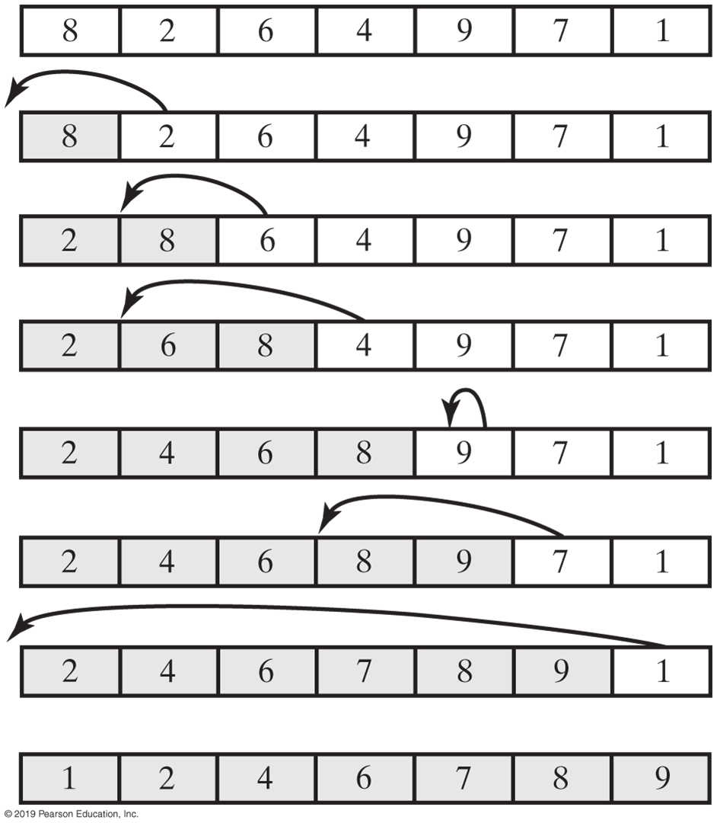
Insertion Sort
FIGURE 15-6 An insertion sort of an array of integers into ascending order

Slide 18
Iterative Insertion Sort
Algorithm insertionSort(a, first, last)
// Sorts the array entries a[first] through a[last] iteratively.
for (unsorted = first + 1 through last)
{
nextToInsert = a[unsorted] insertInOrder(nextToInsert, a, first, unsorted − 1)
}
Iterative algorithm describes an insertion sort of the entries at indices first through last of the array a

Slide 19
Iterative Insertion Sort
Algorithm insertInOrder(anEntry, a, begin, end)
// Inserts anEntry into the sorted entries a[begin] through a[end].
index = end // Index of last entry in the sorted portion
// Make room, if needed, in sorted portion for another entry
while ( (index >= begin) and (anEntry < a[index]) )
{
a[index + 1] = a[index] // Make room
index−−
}
// Assertion: a[index + 1] is available.
a[index + 1] = anEntry // Insert
Pseudocode of method, insertInOrder, to perform the insertions.

Slide 20
Recursive Insertion Sort
Algorithm insertionSort(a, first, last)
// Sorts the array entries a[first] through a[last] recursively.
if (the array contains more than one entry)
{
Sort the array entries a[first] through a[last − 1]
Insert the last entry a[last] into its correct sorted position within the rest of the array
}
This pseudocode describes a recursive insertion sort.

Slide 21
Recursive Insertion Sort
public static <T extends Comparable<? super T>>
void insertionSort(T[] a, int first, int last)
{
if (first < last)
{
// Sort all but the last entry
insertionSort(a, first, last - 1);
// Insert the last entry in sorted order
insertInOrder(a[last], a, first, last - 1);
} // end if
} // end insertionSort
Implementing the algorithm in Java

Slide 22
Recursive Insertion Sort
Algorithm insertInOrder(anEntry, a, begin, end)
// Inserts anEntry into the sorted array entries a[begin] through a[end].
// First draft.
if (anEntry >= a[end])
a[end + 1] = anEntry
else
{
a[end + 1] = a[end] insertInOrder(anEntry, a, begin, end − 1)
}
First draft of insertInOrder algorithm.

Slide 23
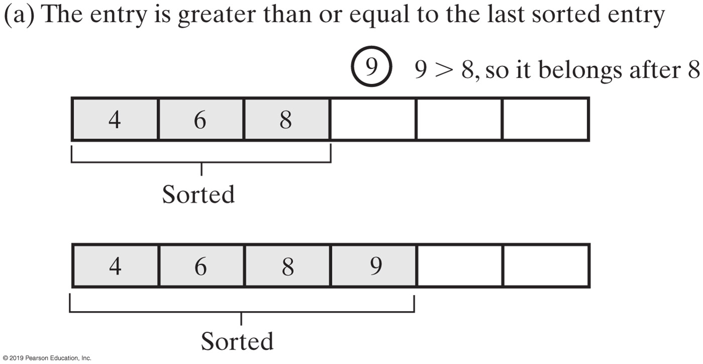
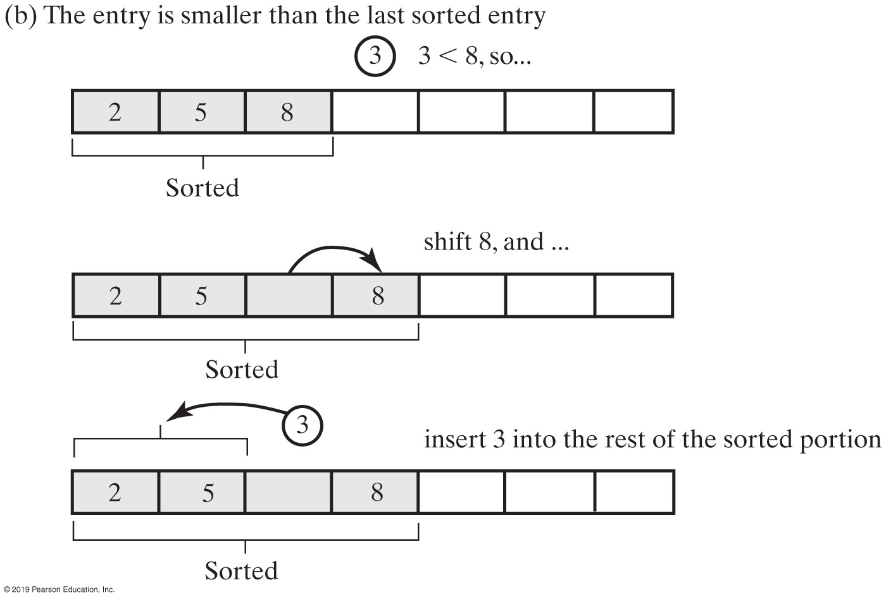
Insertion Sort
FIGURE 15-7 Inserting the first unsorted entry into the sorted portion of the array

Slide 24
Recursive Insertion Sort
Algorithm insertInOrder(anEntry, a, begin, end)
// Inserts anEntry into the sorted array entries a[begin] through a[end].
// Revised draft.
if (anEntry >= a[end])
a[end + 1] = anEntry
else if (begin < end)
{
a[end + 1] = a[end] insertInOrder(anEntry, a, begin, end − 1)
}
else // begin == end and anEntry < a[end]
{
a[end + 1] = a[end]
a[end] = anEntry
}
The algorithm insertInOrder: final draft. Note: insertion sort efficiency (worst case) is O(n²)

Slide 25

Insertion Sort with a Linked Chain
FIGURE 15-8 A chain of integers sorted into ascending order

Slide 26
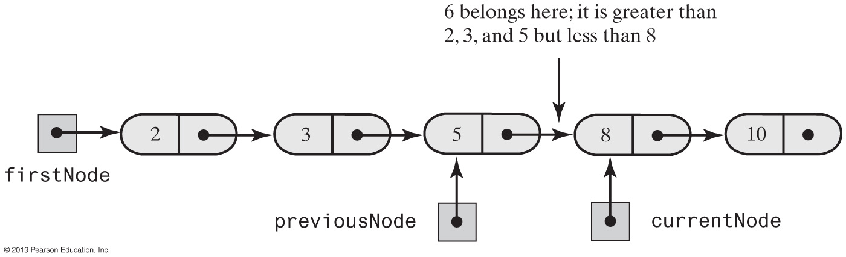
Insertion Sort with a Linked Chain
FIGURE 15-9 During the traversal of a chain to locate the insertion point, save a reference to the node before the current one

Slide 27
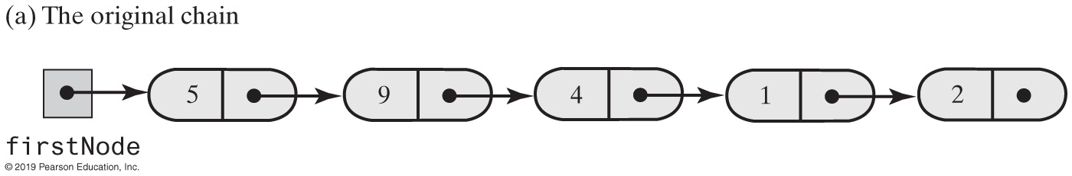
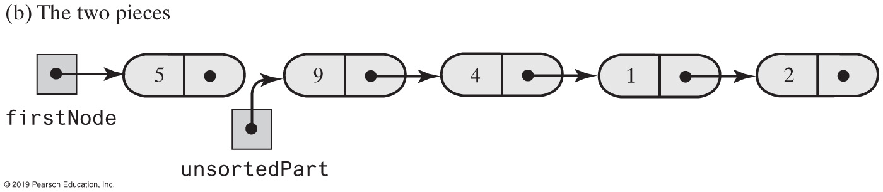
Insertion Sort with a Linked Chain
FIGURE 15-10 Breaking a chain of nodes into two pieces as the first step in an insertion sort

Slide 28
Insertion Sort with a Linked Chain
public class LinkedGroup<T extends Comparable<? super T>>
{
private Node firstNode;
int length; // Number of objects in the group
// . . .
private class Node
{
// private inner class Node is implemented here.
}
Add a sort method to a class LinkedGroup that uses a linked chain to represent a certain collection

Slide 29
Insertion Sort with a Linked Chain
private void insertInOrder(Node nodeToInsert)
{
T item = nodeToInsert.getData();
Node currentNode = firstNode;
Node previousNode = null;
// Locate insertion point
while ( (currentNode != null) &&
(item.compareTo(currentNode.getData()) > 0) )
{
previousNode = currentNode;
currentNode = currentNode.getNextNode();
} // end while
// Make the insertion
if (previousNode != null)
{ // Insert between previousNode and currentNode
previousNode.setNextNode(nodeToInsert);
nodeToInsert.setNextNode(currentNode);
}
else // Insert at beginning
{
nodeToInsert.setNextNode(firstNode);
firstNode = nodeToInsert;
} // end if
} // end insertInOrder
Class has an inner class Node with set and get methods

Slide 30
Insertion Sort with a Linked Chain
public void insertionSort()
{
// If fewer than two items are in the list, there is nothing to do
if (length > 1)
{
// Assertion: firstNode != null
// Break chain into 2 pieces: sorted and unsorted
Node unsortedPart = firstNode.getNextNode();
// Assertion: unsortedPart != null
firstNode.setNextNode(null);
while (unsortedPart != null)
{
Node nodeToInsert = unsortedPart;
unsortedPart = unsortedPart.getNextNode();
insertInOrder(nodeToInsert);
} // end while
} // end if
} // end insertionSort
Insertion sort method

Slide 31
Shell Sort
Algorithms so far are simple
but inefficient for large arrays at O(n²)
The more sorted an array is, the less work insertInOrder must do
Improved insertion sort developed by Donald Shell

Slide 32
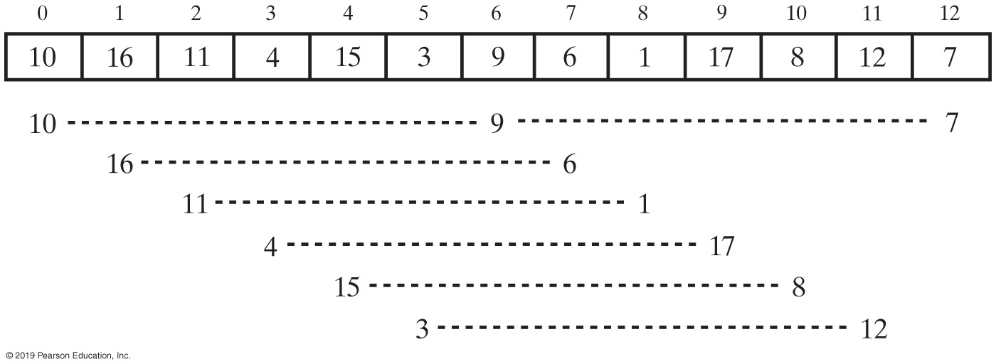
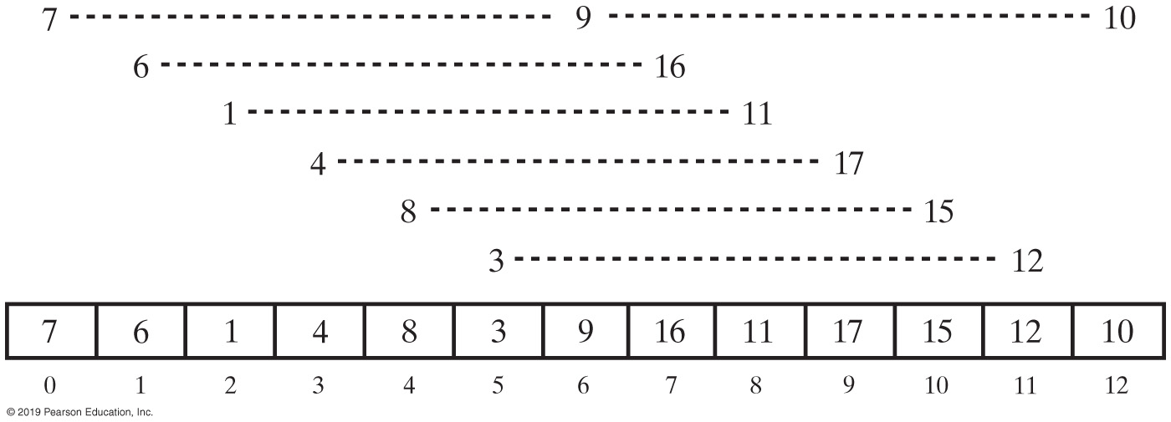
Shell Sort
Before Ordering
After Ordering
FIGURE 15-11 An array and the groups of entries whose indices are 6 apart before and after ordering groups

Slide 33
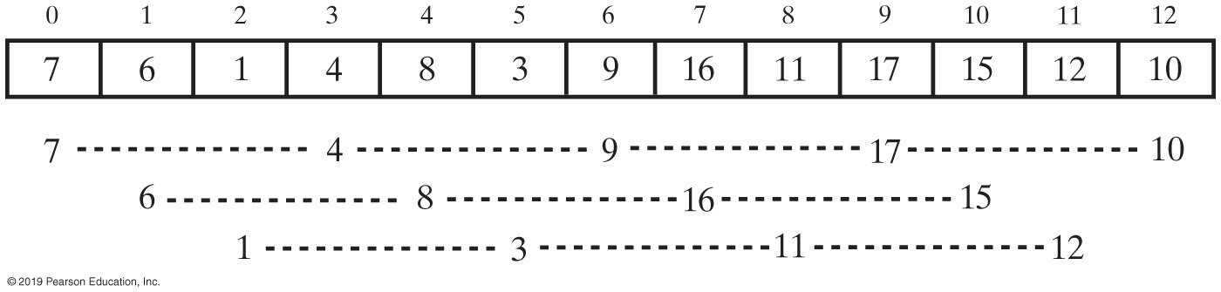
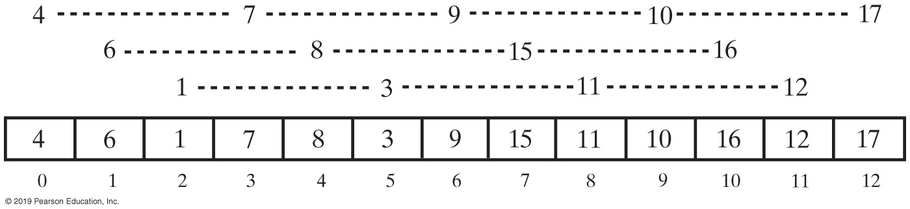
Shell Sort
Before Ordering
After Ordering
Grouped entries in the array in Figure 15-12 whose indices are 3 apart before and after ordering groups

Slide 34
Comparing Algorithms
 | Best Case | Average Case | Worst Case
Selection Sort | O(n²) | O(n²) | O(n²)
Insertion Sort | O(n) | O(n²) | O(n²)
Shell Sort | O(n) | O(n^{1.5}) | O(n^{1.5})
FIGURE 15-15 The time efficiencies of three sorting algorithms, expressed in Big Oh notation

Slide 35
Merge Sort
Divides an array into halves
Sorts the two halves,
Then merges them into one sorted array.
The algorithm for merge sort is usually stated recursively.
Major programming effort is in the merge process

Slide 36
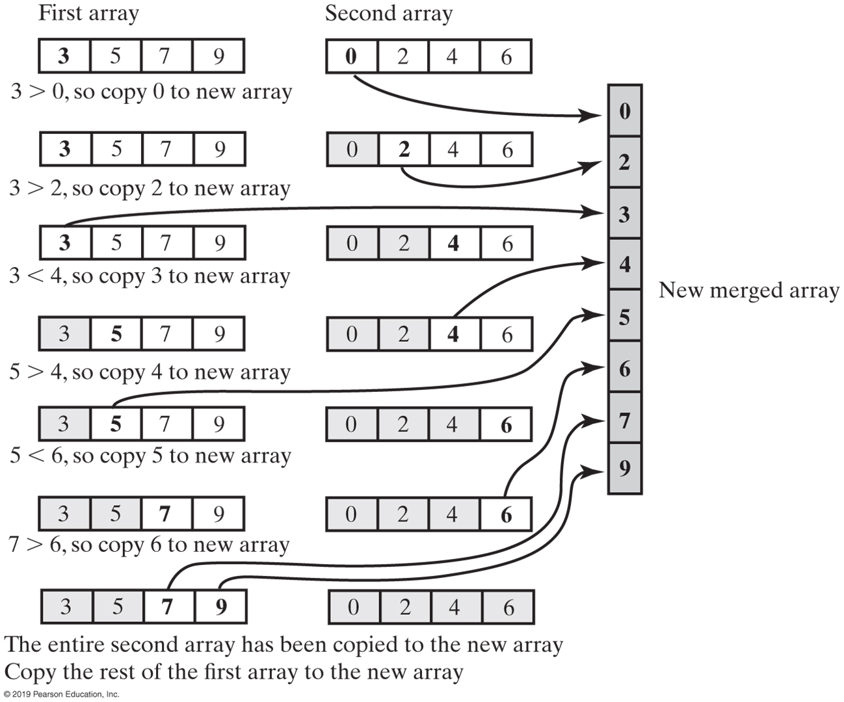
Merge Sort
FIGURE 16-1 Merging two sorted arrays into one sorted array

Slide 37
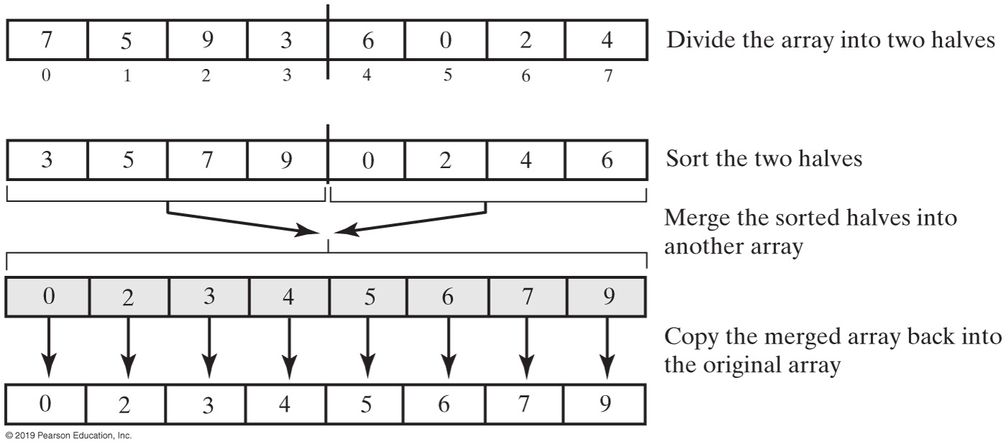
Marge Sort
FIGURE 16-2 The major steps in a merge sort

Slide 38
Recursive Merge Sort
Algorithm mergeSort(a, tempArray, first, last)
// Sorts the array entries a[first..last] recursively.
if (first < last)
{
mid = approximate midpoint between first and last
mergeSort(a, tempArray, first, mid)
mergeSort(a, tempArray, mid + 1, last)
Merge the sorted halves a[first..mid] and a[mid + 1..last] using the array tempArray
}
Recursive algorithm for merge sort.

Slide 39
Recursive Merge Sort
Algorithm merge(a, tempArray, first, mid, last)
// Merges the adjacent subarrays a[first..mid] and a[mid + 1..last].
beginHalf1 = first endHalf1 = mid beginHalf2 = mid + 1 endHalf2 = last
// While both subarrays are not empty, compare an entry in one subarray with
// an entry in the other; then copy the smaller item into the temporary array
index = 0 // Next available location in tempArray
while ( (beginHalf1 <= endHalf1) and (beginHalf2 <= endHalf2) )
{
if (a[beginHalf1] <= a[beginHalf2])
{
tempArray[index] = a[beginHalf1] beginHalf1++
}
else
{
tempArray[index] = a[beginHalf2] beginHalf2++
}
index++
}
// Assertion: One subarray has been completely copied to tempArray.
Copy remaining entries from other subarray to tempArray
Copy entries from tempArray to array a
Pseudocode which describes the merge step.

Slide 40
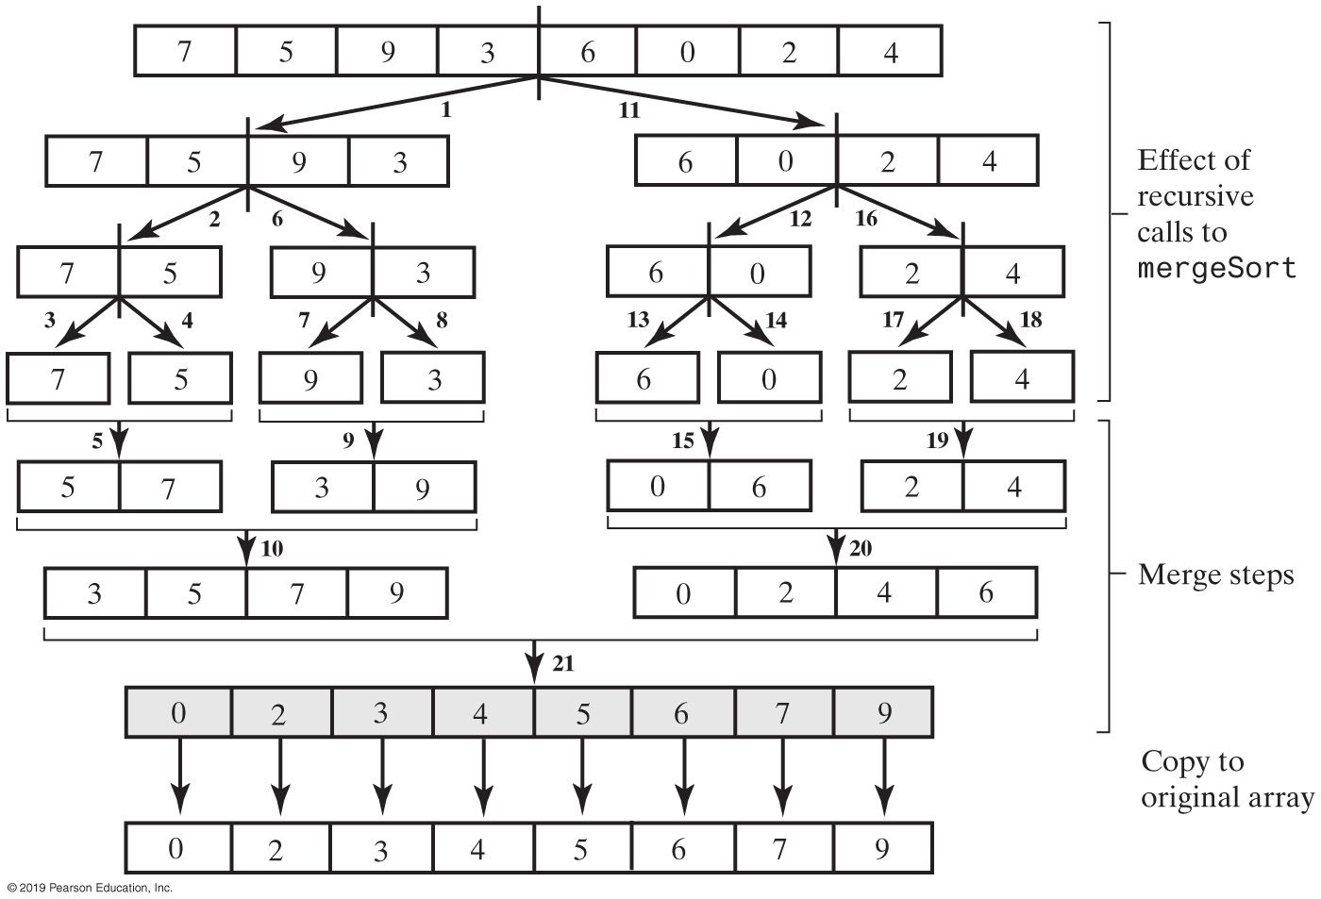
Merge Sort
FIGURE 16-3 The effect of the recursive calls and the merges during a merge sort

Slide 41
Recursive Merge Sort
public static <T extends Comparable<? super T>>
void mergeSort(T[] a, int first, int last)
{
// The cast is safe because the new array contains null entries
@SuppressWarnings("unchecked")
T[] tempArray = (T[])new Comparable<?>[a.length]; // Unchecked cast
mergeSort(a, tempArray, first, last);
} // end mergeSort
Be careful to allocate the temporary array only once.

Slide 42
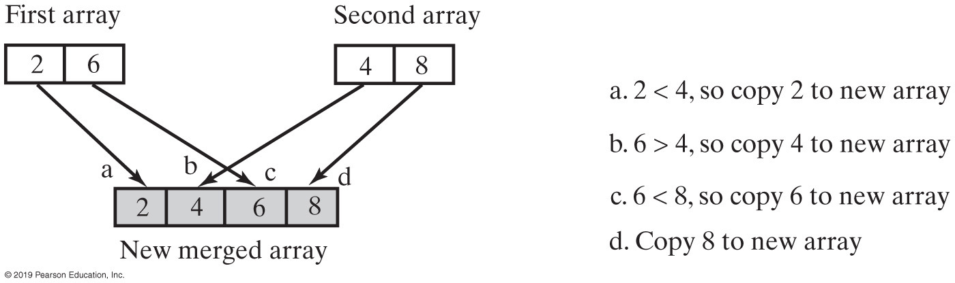
Merge Sort
Efficiency is O(n log n)
FIGURE 16-4 A worst-case merge of two sorted arrays

Slide 43
Iterative Merge Sort
Less simple than recursive version.
Need to control the merges.
Will be more efficient of both time and space.
But, trickier to code without error.

Slide 44
Iterative Merge Sort
Starts at beginning of array
Merges pairs of individual entries to form two-entry subarrays
Returns to the beginning of array and merges pairs of the two-entry subarrays to form four-entry subarrays
And so on
After merging all pairs of subarrays of a particular length, might have entries left over.

Slide 45
Merge Sort in the Java Class Library
Class Arrays in the package java.util defines versions of a static method sort
public static void sort(Object[] a)
public static void sort(Object[] a, int first, int after)

Slide 46
Quick Sort
Divides an array into two pieces
Pieces are not necessarily halves of the array
Chooses one entry in the array—called the pivot
Partitions the array

Slide 47
Quick Sort
When pivot chosen, array rearranged such that:
Pivot is in position that it will occupy in final sorted array
Entries in positions before pivot are less than or equal to pivot
Entries in positions after pivot are greater than or equal to pivot

Slide 48
Quick Sort
Algorithm quickSort(a, first, last)
// Sorts the array entries a[first..last] recursively.
if (first < last)
{
Choose a pivot
Partition the array about the pivot
pivotIndex = index of pivot
quickSort(a, first, pivotIndex − 1) // Sort Smaller
quickSort(a, pivotIndex + 1, last) // Sort Larger
}
Algorithm that describes our sorting strategy

Slide 49
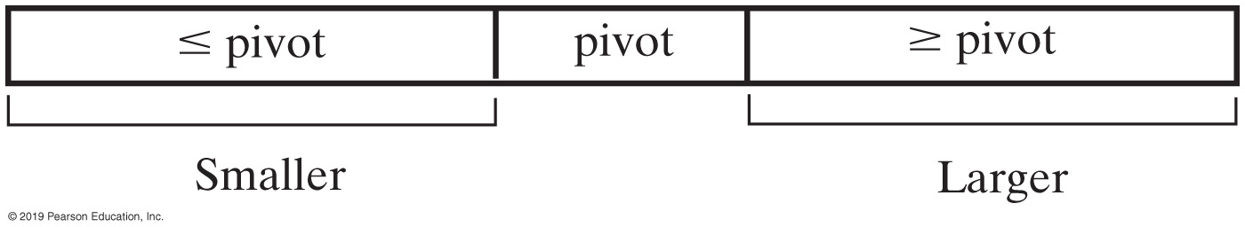
Quick Sort
FIGURE 16-5 A partition of an array during a quick sort

Slide 50
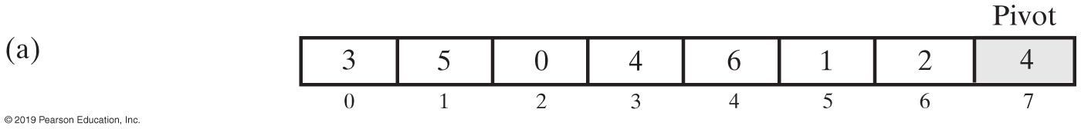
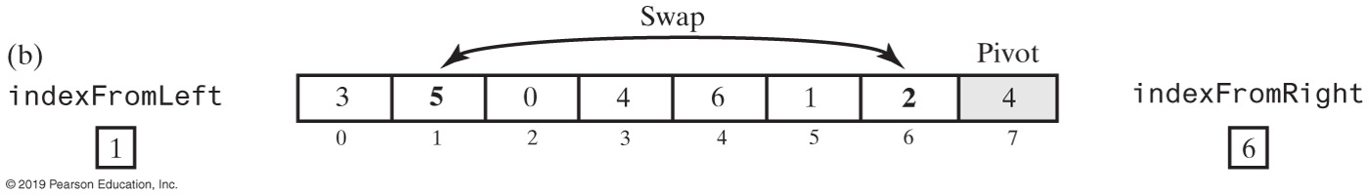
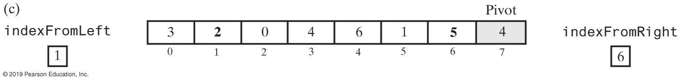
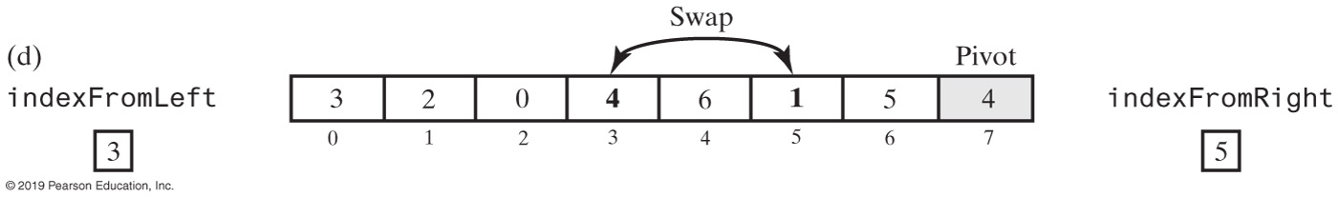
Quick Sort Partitioning (Part 1)
FIGURE 16-6 A partitioning strategy for quick sort

Slide 51
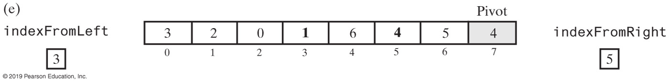
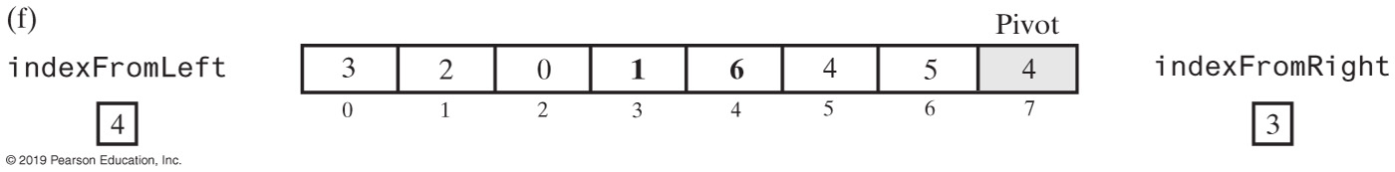
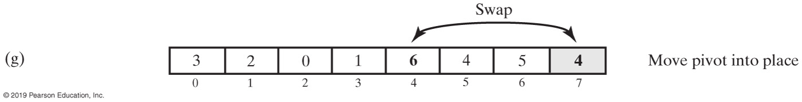
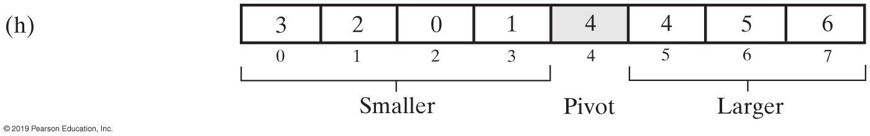
Quick Sort Partitioning (Part 2)
FIGURE 16-6 A partitioning strategy for quick sort

Slide 52
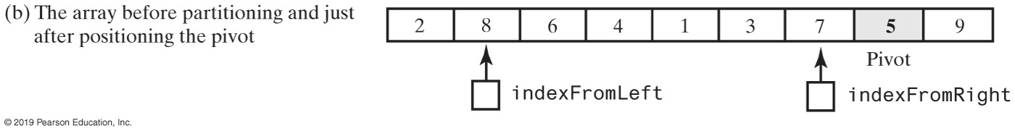
Quick Sort Partitioning
FIGURE 16-7 Median-of-three pivot selection

Slide 53
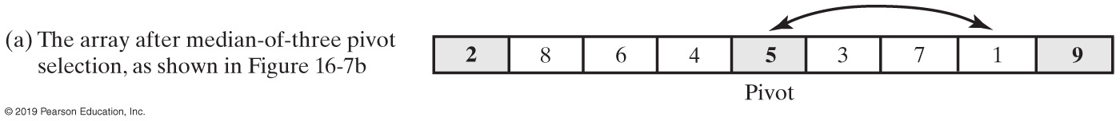
Quick Sort Partitioning
FIGURE 16-8 The array after selecting and positioning the pivot and just before partitioning

Slide 54
Quick Sort Partitioning (Part 1)
Algorithm partition(a, first, last)
// Partitions an array a[first..last] as part of quick sort into two subarrays named
// Smaller and Larger that are separated by a single entry—the pivot—named pivotValue.
// Entries in Smaller are <= pivotValue and appear before pivotValue in the array.
// Entries in Larger are >= pivotValue and appear after pivotValue in the array.
// Precondition: first >= 0; first < a.length; last – first >= 3; last < a.length.
// Returns the index of the pivot.
mid = index of the array’s middle entry
sortFirstMiddleLast(a, first, mid, last)
// Assertion: a[mid] is the pivot, that is, pivotValue;
// a[first] <= pivotValue and a[last] >= pivotValue, so do not compare these two
// array entries with pivotValue.
// Move pivotValue to next-to-last position in array Exchange a[mid] and a[last – 1]
pivotIndex = last – 1 pivotValue = a[pivotIndex]
Adjusting the Partition Algorithm

Slide 55
Quick Sort Partitioning (Part 2)
// Determine two subarrays:
// Smaller = a[first..endSmaller] and
// Larger = a[endSmaller+1..last–1]
// such that entries in Smaller are <= pivotValue and entries in Larger are >= pivotValue.
// Initially, these subarrays are empty.
indexFromLeft = first + 1 indexFromRight = last − 2
done = false
while (!done)
{
// Starting at the beginning of the array, leave entries that are < pivotValue and
// locate the first entry that is >= pivotValue. You will find one, since the last
// entry is >= pivotValue.
while (a[indexFromLeft] < pivotValue)
indexFromLeft++
// Starting at the end of the array, leave entries that are > pivotValue and
// locate the first entry that is <= pivotValue. You will find one, since the first
// entry is <= pivotValue.
while (a[indexFromRight] > pivotValue)
indexFromRight−−
Adjusting the Partition Algorithm

Slide 56
Quick Sort Partitioning (Part 3)
// Assertion: a[indexFromLeft] >= pivotValue and
// a[indexFromRight] <= pivotValue
if (indexFromLeft < indexFromRight)
{
Exchange a[indexFromLeft] and a[indexFromRight]
indexFromLeft++
indexFromRight−−
}
else
done = true
} // while (!done)
// Place pivotValue between the subarrays Smaller and Larger
Exchange a[pivotIndex] and a[indexFromLeft]
pivotIndex = indexFromLeft
// Assertion: Smaller = a[first..pivotIndex–1]
// pivotValue = a[pivotIndex]
// Larger = a[pivotIndex+1..last]
return pivotIndex
Adjusting the Partition Algorithm

Slide 57
The Quick Sort Method
public static <T extends Comparable<? super T>>
void quickSort(T[] a, int first, int last)
{
if (last - first + 1 < MIN_SIZE)
{
insertionSort(a, first, last);
}
else
{
// Create the partition: Smaller | Pivot | Larger
int pivotIndex = partition(a, first, last);
// Sort subarrays Smaller and Larger
quickSort(a, first, pivotIndex - 1);
quickSort(a, pivotIndex + 1, last);
} // end if
} // end quickSort
Implementation of the quick sort.

Slide 58
Quick Sort in the Java Class Library
Class Arrays in the package java.util defines versions of a static method sort
public static void sort(type[] a)
public static void sort(type[] a, int first, int after)

Slide 59
Radix Sort
Does not use comparison
Treats array entries as if they were strings that have the same length.
Group integers according to their rightmost character (digit) into “buckets”
Repeat with next character (digit), etc.

Slide 60
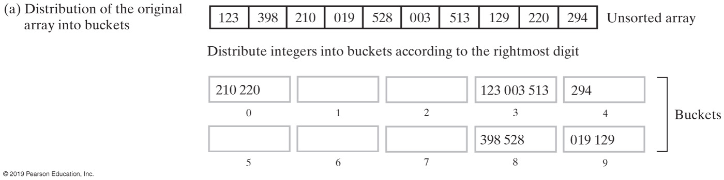
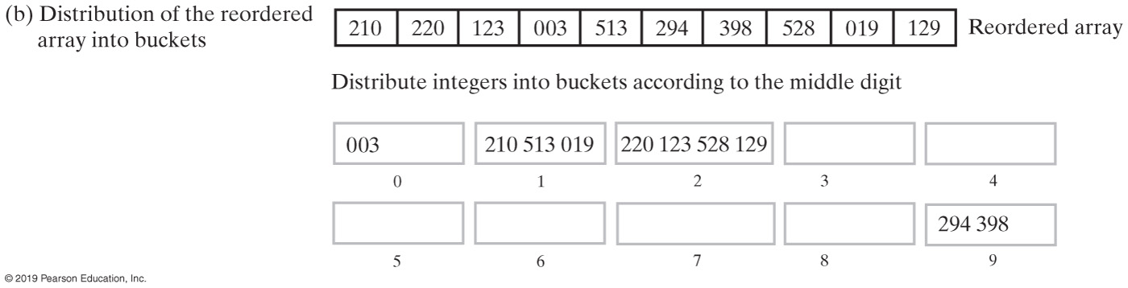
Radix Sort (Part 1)
FIGURE 16-9 The steps of a radix sort

Slide 61
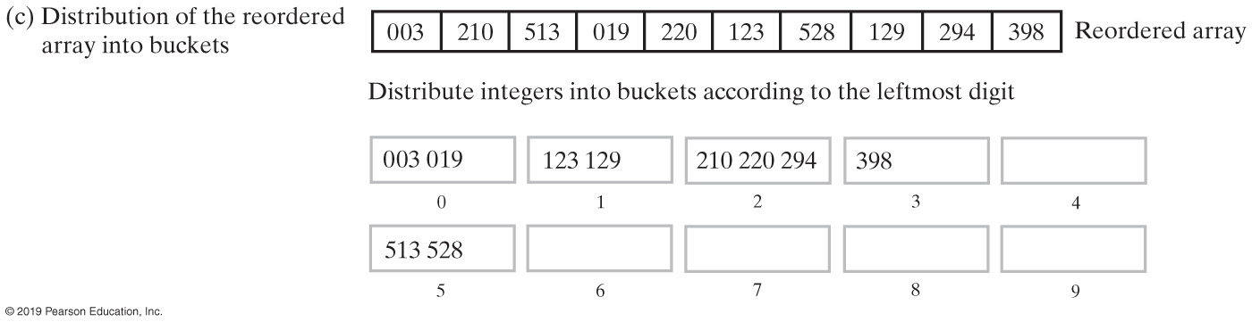
Radix Sort (Part 2)
FIGURE 16-9 The steps of a radix sort

Slide 62
Algorithm Comparison
 | Best Case | Average Case | Worst Case
Radix Sort | O(n) | O(n) | O(n)
Merge Sort | O(n log n) | O(n log n) | O(n log n)
Quick Sort | O(n log n) | O(n log n) | O(n²)
Shell Sort | O(n) | O(n^{1.5}) | O(n^{1.5})
Insertion Sort | O(n) | O(n²) | O(n²)
Selection Sort | O(n²) | O(n²) | O(n²)
FIGURE 16-10 The time efficiency of various sorting algorithms, expressed in Big Oh notation

Slide 63
Comparing Function Growth Rates
 | 10 | 10² | 10³ | 10⁴ | 10⁵ | 10⁶
n | 10 | 100 | 1,000 | 10,000 | 100,000 | 1,000,000
n log n | 33 | 664 | 9,966 | 132,877 | 1,660,964 | 19,931,569
n^{1.5} | 32 | 1,000 | 31,623 | 1,000,000 | 319,622,777 | 109
n² | 100 | 10,000 | 1,000,000 | 108 | 1,010 | 1,012
FIGURE 16-11 A comparison of growth-rate functions as n increases

Slide 64
Binary Tree Sort
Items to be sorted are inserted into a Binary Search tree
An LNR (inorder) traversal visits the items in ascending order
An RNL traversal visits the items in decending order
Its algorithm is basically the Binary Search Tree’s Insert algorithm
Its sort effort can approach the minimum O(nlog₂n) for a balanced tree or be O(n²) for a skewed tree.
It is one of the few algorithms not to perform swaps
Its overhead is high
64

Slide 65
Binary Tree Sort Performance Summary
algorithm | speed |  | memory overhead
 | range | Effort and Swaps | range | bytes | Comments
Binary Tree | fast/slow O(log₂n)/ O(n²) | (n+1) [ log₂(n+1) – 2 ] < SE <= n²/2 - n/2 | high | 8n | Fast for random data, slow for already sorted data. Highest Overhead
65

Slide 66
Binary Tree Sort Algorithm
1. The first item becomes the root node.
2. For any subsequent item, consider the root node to be a root of a subtree, and start at the root of this subtree.
3. Compare the item to the root of the subtree.
3.1.1 If the new item is less than the subtree’s root, then the new subtree is the root’s left subtree
3.1.2 Else the new subtree is the root’s right subtree.
4. Repeat step 3 until the new subtree is empty. Position the new item as the root of this empty subtree.
5. Repeat steps 2, 3 and 4 for each item to be sorted
An LNR (inorder) traversal Outputs the items in ascending order
66

Slide 67
Binary Tree Sort Algorithm Graphical Representation
50
50
50
50
40
40
40
47
47
50
50
50
63
40
63
40
63
40
63
47
55
47
55
47
55
43
43
50
40
63
70, 80, 35, 68
35
47
55
70
43
68
80
67

Slide 68
Sort Effort of the Binary Tree Sort
Low when the items to be sorted are in random order (or close to randomized)
The tree is balanced
Zero comparisons for first item; < log2(n+1) comparisons per item for all subsequent items; O(nlog2n)
High when the items to be sorted are already sorted (or closed to sorted)
The tree is highly skewed
Zero comparisons for the first item, 1 for the second, 2 for the third, … n-1 for the nth; O(n^2)
5
3
7
2
4
6
9
2
4
7
9
68

